Slide 1


Identifying Exogenous Variables for Forecasting GRACE Dataset
$$AI for Life Science −Challenge 2$$

Slide 2
Team Poseidon – AI4LS
Daramola
Oluwasegun
Akomolafe
Ayobami
Adedeji
Roqeeb
Agboeze
Tochukwu

Slide 3
Introduction
Approach: Identifying and leveraging a set of exogenous variables Forecasting Gravity Recovery and Climate Experiment (GRACE) and GRACE Follow-On (GRACE-FO) groundwater data over a five-year horizon by
Our approach involves integrating these variables into several forecasting models to evaluate their predictive power individually and collectively. By employing a variety of modelling techniques such as Dynamic GAMs and Random Forests—we assessed the contribution of each exogenous variable to groundwater level predictions. This multi-model strategy allows us to robustly demonstrate the predictive power of the variables, identify which factors most significantly impact the forecasts, and enhance the overall accuracy of our groundwater predictions.
To enhance the accuracy of our forecasts, we utilized the ERA5 Monthly Averaged Reanalysis dataset to obtain relevant exogenous variables (shown in the next slide).

Slide 4
Selected Exogenous Variables from ERA5
Variable Name | Symbol | Units | Description
2m Temperature | t2m | K (Kelvin) | Temperature of air at 2 meters above the surface.
Snowfall | sf | m of water equivalent | Amount of snow that has melted.
Snowmelt | smlt | m of water equivalent | Amount of snow that has melted
Skin Reservoir Content | src | m | Amount of water stored in the skin reservoir
Volumetric Soil Water Layer 4 | swvl4 | m³/m³ (cubic meters per cubic meter) | Volumetric soil water content for soil layer 4 (approximately 100-289 cm depth).
Surface Runoff | sro | m | Water from precipitation that does not infiltrate the soil and runs off the surface
Total Evaporation | e | m of water equivalent | Total amount of water evaporated from the Earth's surface, including transpiration
Total Precipitation | tp | m | Total amount of precipitation (rainfall and snowfall).
Leaf Area Index, High Vegetation | lai_hv | Dimensionless | Leaf area index for high vegetation (e.g., forests).
Leaf Area Index, Low Vegetation | lai_lv | Dimensionless | Leaf area index for low vegetation (e.g., grasses, shrubs).

Slide 5

Analysis Approach (Pipeline)
GRACE Dataset
Land Mask Filtering
Combining with ERA5
Merging the two datasets
Interpolation of GRACE and ERA5 Grids
Model Training
Feature Importance Analysis
Predictive Power Ranking
Google Cloud Platform
Notes:
Feature Importance “Analysis”

Slide 6
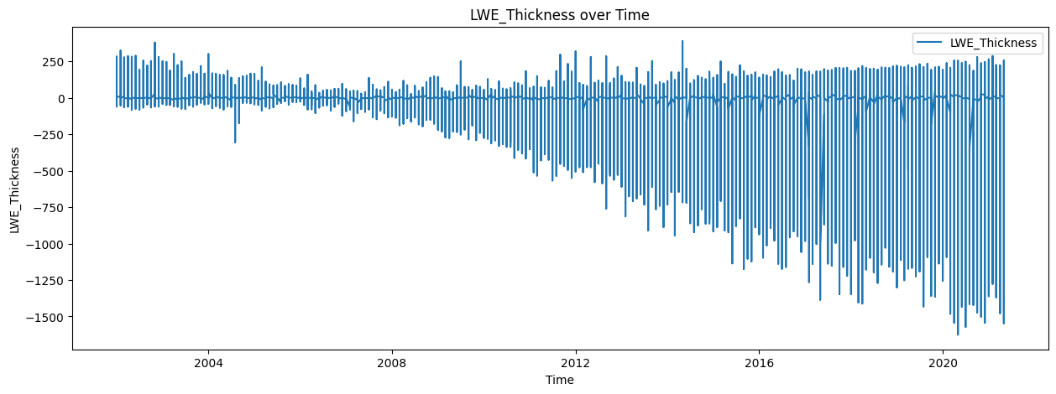
Explotatory Data Analysis
Total GRACE Datapoints | 222,783,730
GRACE datapoints (Land) | 80,510,586
GRACE datapoints (Ocean) | 142,273,144
GRACE timeline | 2002 – 2021
Train Duration | 2002 – 2015
Test Duration | 2016 - 2021
Notes:
This chart shows the LWE_Thickness (Liquid Water Equivalent Thickness) over time, which is a measure used in GRACE (Gravity Recovery and Climate Experiment) satellite data to represent changes in water storage. The x-axis represents time, spanning from approximately 2002 to 2021, while the y-axis shows the LWE_Thickness values in millimeters.
Key Points:
Declining Trend: The graph shows a significant downward trend in LWE_Thickness over time, indicating a reduction in water storage or groundwater levels. This likely reflects long-term depletion of groundwater or loss of water mass in the studied region.
Seasonal and Interannual Variability:
The vertical spikes represent seasonal or interannual variability in water storage, with periods of high gain and loss.
These fluctuations are likely tied to seasonal weather patterns (e.g., rainfall, snowmelt, and evaporation rates).
Increasing Amplitude:
The amplitude of these fluctuations appears to increase over time, especially after 2010. This may suggest more extreme seasonal changes, where wet and dry periods have become more pronounced.

Slide 7
Machine Learning Models
RandomForest Regressor Model
XG-Boost Regressor Model
Catboost Regressor Model
Decision Tree Regressor Model
Dynamic Generalized Additive Model (DGAM)
DGAM was consulted because of the model's ability to account for discrete non-linear values better than the conventional algorithms.
Notes:
Generalised additive models (GAMs) are increasingly popular tools for estimating smooth nonlinear relationships between predictors and response variables. GAMs are particularly relevant in ecology for representing hierarchical functions for discrete responses that encompass complex features including zero inflation, truncation and uneven sampling. However, GAMs are less useful for producing forecasts as their smooth functions provide unstable predictions outside the range of training data.
We introduce dynamic generalised additive models (DGAMs), where the GAM linear predictor is jointly estimated with unobserved dynamic components to model time series that evolve as a function of nonlinear predictor associations and latent temporal processes. These models are especially useful for analysing multiple series, as they can estimate hierarchical smooth functions while learning complex temporal associations via dimension-reduced latent factor processes. We implement our models in the mvgam R package, which estimates unobserved parameters for smoothing splines and latent temporal processes in a probabilistic framework.
Using simulations, we illustrate how our models outperform competing formulations in realistic ecological forecasting tasks while identifying important smooth predictor functions. We use a real-world case study to highlight some of mvgam's key features, which include functions for calculating correlations among series' latent trends, performing model selection using rolling window forecasts and posterior predictive checks, online data augmentation via a recursive particle filter and visualising probabilistic uncertainties for smooth functions and predictions.
Dynamic GAMs (DGAMs) offer a solution to the challenge of forecasting discrete time series while estimating ecologically relevant nonlinear predictor associations. Our Bayesian latent factor approach will be particularly useful for exploring competing dynamic ecological models that encompass hierarchical smoothing structures while providing forecasts with robust uncertainties, tasks that are becoming increasingly important in applied ecology.

Slide 8
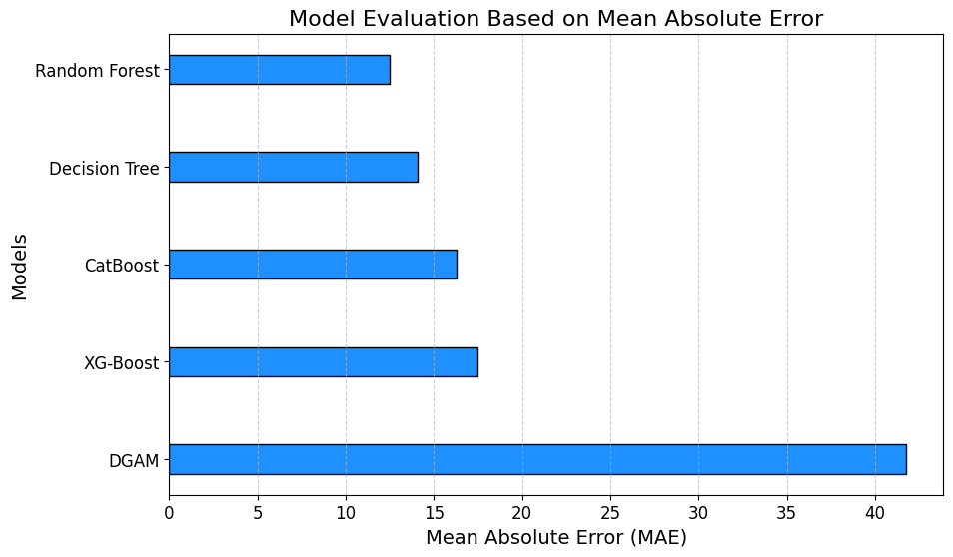
Notes:
This identifies RandomForest as the best performing model with lowest error margin for the forecast analysis

Slide 9
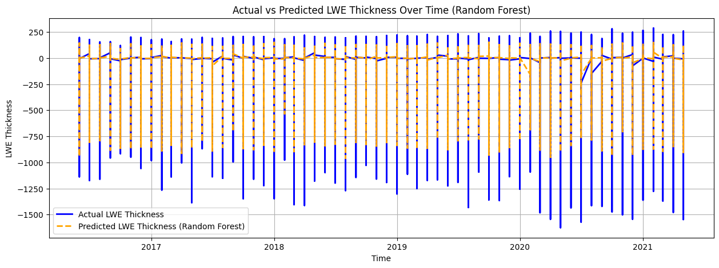
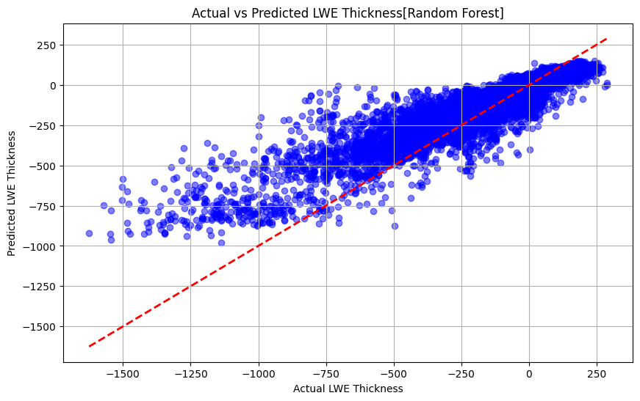
Random Forest Model
Averaged Random Forest Accuracy Metrics:
Mean Squared Error: 1158.86
Mean Absolute Error: 12.71
R-squared: 0.81

Slide 10
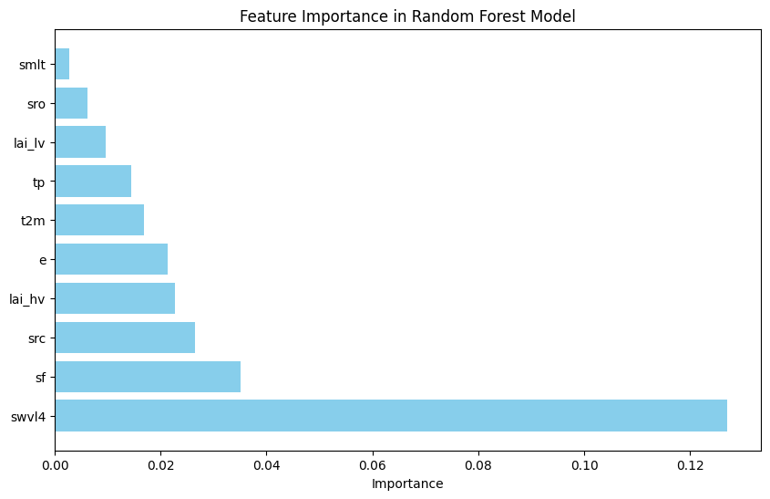
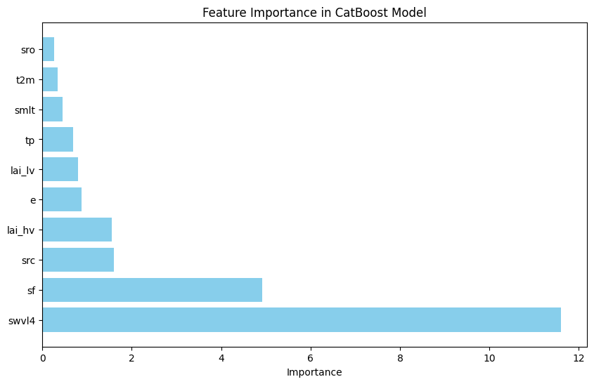
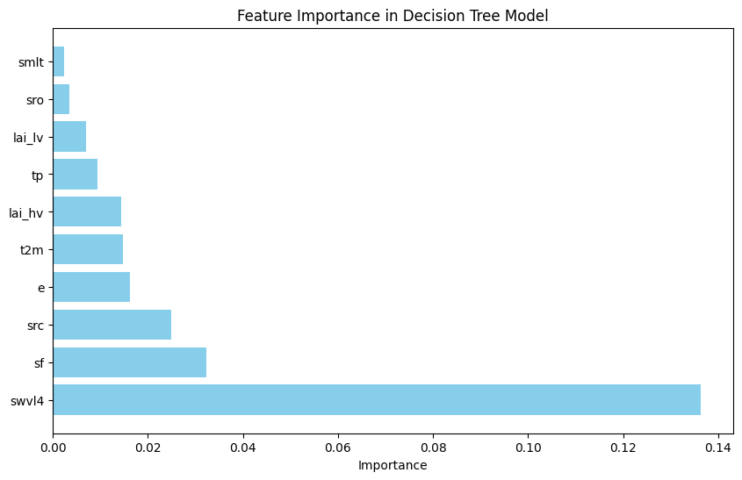
Main Results and Interpretation (1)
The feature importance plot for this analysis highlights the impact of the exogenous features on the model's predictive performance.
All models trained for this analysis identified Soil Water Volumetric Level 4 (swvl4) as the variable with the highest importance to model output. With other variables, following in rank

Slide 11
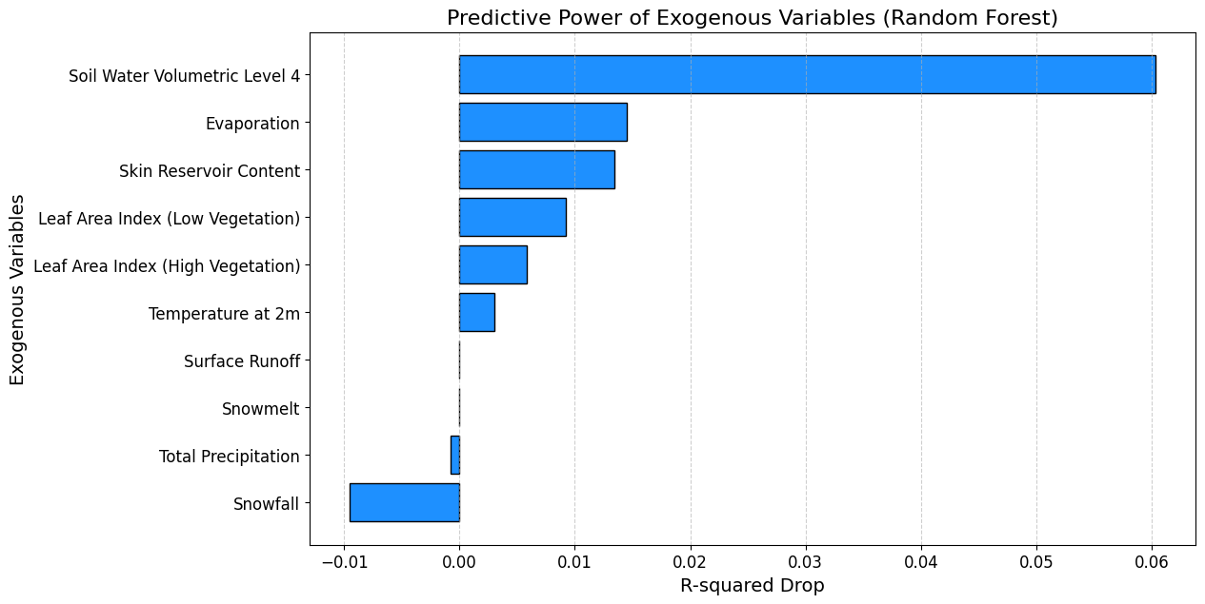
Main Results and Interpretation (2)
Based on the Feature ablation analysis using the best performing model, RandomForest, Soil Water Volumetric Level 4 (swvl4) is identified as the top exogenous variable with the highest predictive power for predicting LWE Thickness. Removing swvl4 caused a sharp decrease in R-squared from 0.1683 to 0.1080 (0.0603). This indicates that this feature is crucial for the model's accuracy.

Slide 12
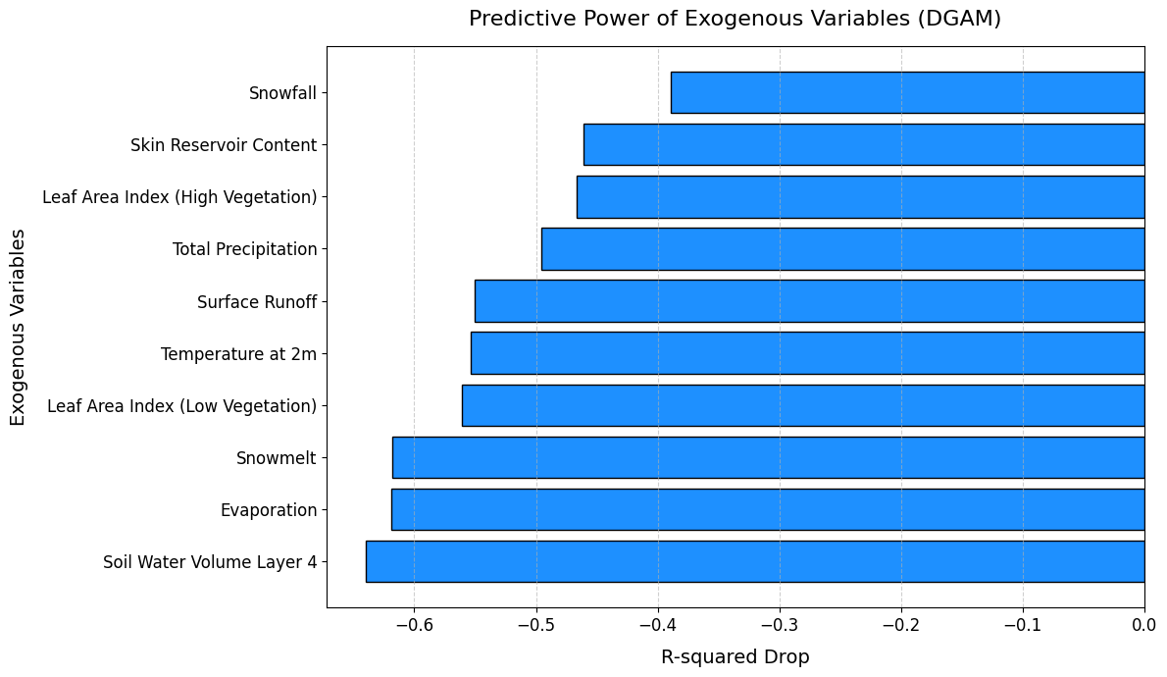
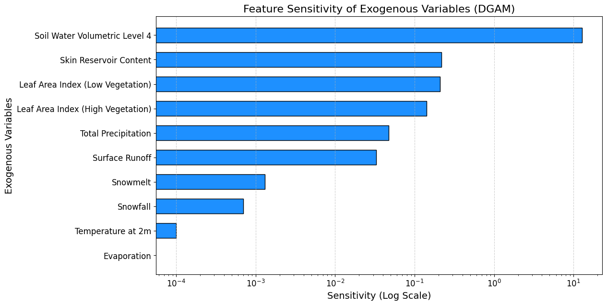
Main Results and Interpretation (3)
Using DGAM, swvl4 was represented to have the highest feature sensitivity of 12.7475 (swvl4 = Feature 6), and the lowest drop of R-squared value of (0.5707).

Slide 13
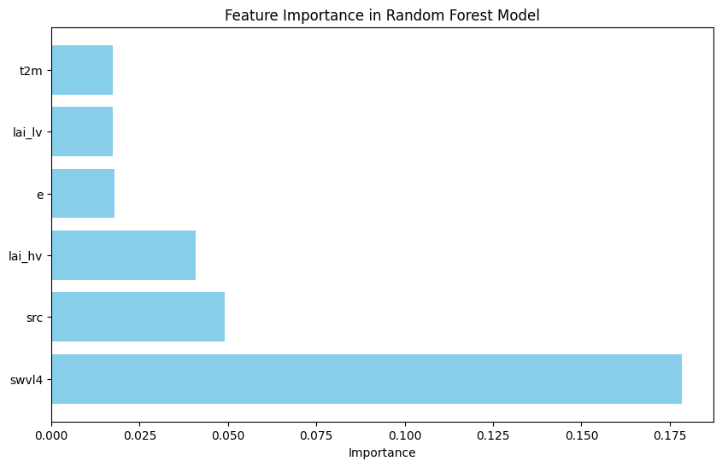
Main Results and Interpretation (4)
After exogenous variables with negligible impact or overfitting consequences were identified and filtered out (sf, smlt, sro, tp) following the variable ranking, performance of model improved (MAE dropped from 12.71 to 11.83), while swvl4 still ranked the most significant exogenous variables.
Avg Accuracy Metrics with all 10 variables:
Mean Squared Error: 1158.86
Mean Absolute Error: 12.71
R-squared: 0.81
Metrics of selected variables:
Mean Squared Error: 888.87
Mean Absolute Error: 11.83
R-squared: 0.84

Slide 14
Possible Scientific or Analytical/technological steps beyond current analysis
Implement Advanced Modelling Techniques
Explore advanced models like MWGR, LSTM and CNN for spatiotemporal analysis
Develop multi-scale models to capture both local and global groundwater dynamics.
Expand Exogenous Variables
Include Human Use/Consumption Data
Add More Variables Beyond Current 10 such as land use changes, groundwater recharge rates, and socio-economic indicators.
Scale Up Compute
Notes:
Expand Exogenous Variables
Include Human Use/Consumption Data
Integrate data on water extraction, irrigation practices, and urban consumption.
Benefit: Enhance model predictions by accounting for anthropogenic impacts on groundwater levels.

Slide 15
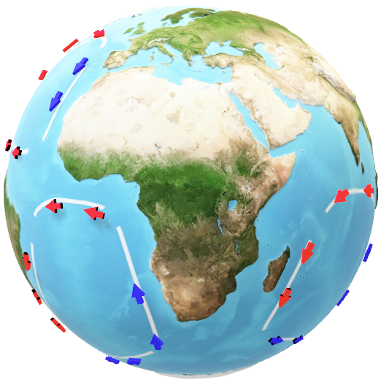
Thank you

